Slide 1

JAZAN UNIVERSITY SPS
One up top team
Under the direct supervision of
Dr. Imad M. Alshiekh

Slide 2
Previously known facts
Jazan university smart parking system is a small project that has been presented to represent solutions for the parking issue at Jazan University.
Parking detector is a small device by which we can determine if there is a car on the park where the device is laying on or not.
The device works by measuring the distance between it and the object in front of it(which is supposed to be a car), and uploading the information to global MySQL database on the world wide web.
The user can easily access the system through our website or using our android app.

Slide 3
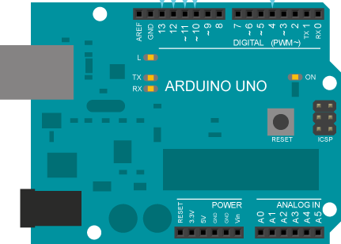
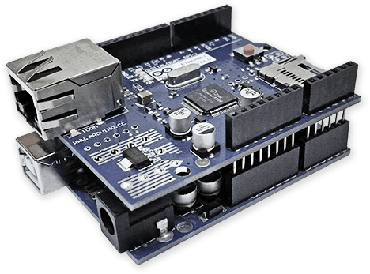
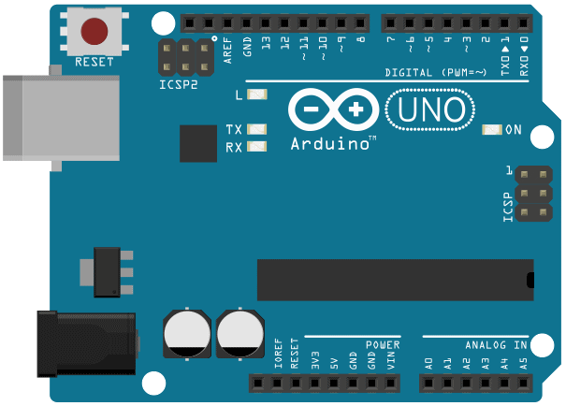
Our parking detector progress
Arduino Uno
cross-network controlling machine
+
Ethernet shield
=

Slide 4
Database structure
description | lat | lng | availability | ID
students parking | 42.548664 | 16.963777 | 0 | 1
staff parking | 42.547192 | 16.963273 | 1 | 2

Slide 5
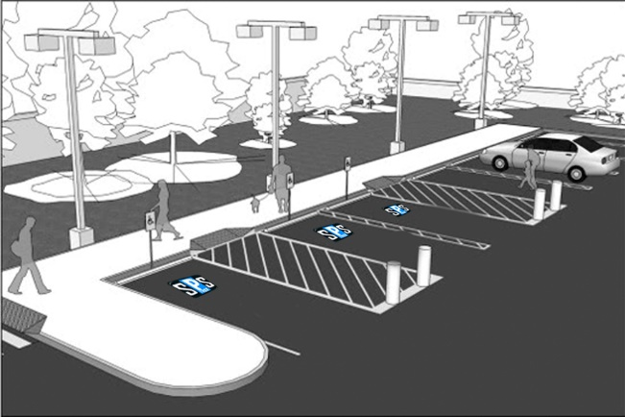

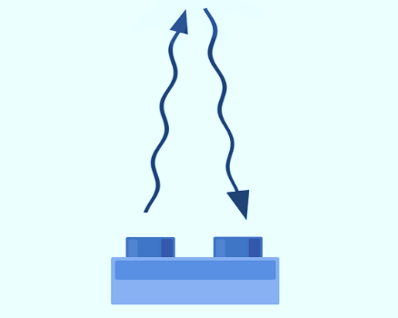
Parking detector update statements
String av="UPDATE `sql2105932`.`Site` SET `availability` = '1' WHERE `Site`.`ID` =1;";
String nav="UPDATE `sql2105932`.`Site` SET `availability` = '0' WHERE `Site`.`ID` =1;";

Slide 6
User’s interaction methods with the system
We’ve created two main methods to make the user interact with our system and get benefits from it.
These methods are :
World Wide Web.
On the following link: http://www.jazanu-sps.com/
Android Platform.

Slide 7
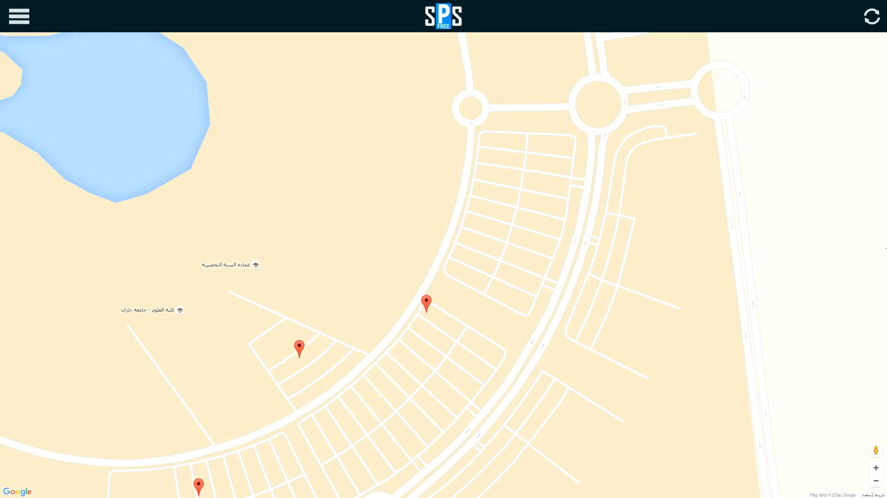
Website preview

Slide 8
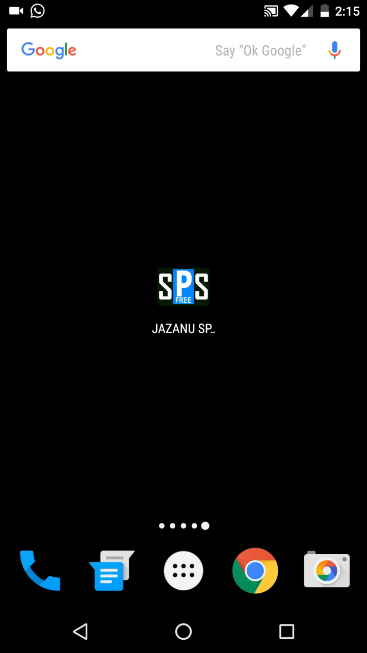
Android app preview

Slide 9




System Architecture

Slide 10

Last but not least
We are more that happy to announce that the project website and the android app are officially published on the internet and the original android market (google play) and they are available for free on both sides.
Use the following QR code to direct you to JASAN UNIVERSITY SPS on android;

Slide 11
Thank you

